Slide 1
Introduction to Git and GitHub
General Assembly – Data Science

Slide 2
Agenda
Introduction
Exploring GitHub
Using Git with GitHub
Contributing on GitHub
Bonus Content

Slide 3
I. Introduction

Slide 4
Why learn version control?
Version control is useful when you write code, and data scientists write code
Enables teams to easily collaborate on the same codebase
Enables you to contribute to open source projects
Attractive skill for employment

Slide 5
What is Git?
Version control system that allows you to track files and file changes in a repository (“repo”)
Primarily used by software developers
Most widely used version control system
Runs from the command line (usually)
Can be used alone or in a team

Slide 6
What is GitHub?
A website, not a version control system
Allows you to put your Git repos online
Largest code host in the world
Benefits of GitHub:
Backup of files
Visual interface for navigating repos
Makes repo collaboration easy
“GitHub is just Dropbox for Git”
Note: Git does not require GitHub

Slide 7
Git can be challenging to learn
Designed (by programmers) for power and flexibility over simplicity
Hard to know if what you did was right
Hard to explore since most actions are “permanent” (in a sense) and can have serious consequences
We’ll focus on the most important 10% of Git

Slide 8
II. Exploring GitHub

Slide 9
GitHub setup
There’s nothing to install
“GitHub for Windows” & “GitHub for Mac” are GUI clients (alternatives to command line)

Slide 10
Navigating a GitHub repo (1 of 2)
Example repo: github.com/reidoffringa/DS-SF-32
Account name, repo name, description
Folder structure
Viewing files:
Rendered view (with syntax highlighting)
Raw view
README.md:
Describes a repo
Automatically displayed
Written in Markdown

Slide 11
Navigating a GitHub repo (2 of 2)
Commits:
One or more changes to one or more files
Revision highlighting
Commit comments are required
Most recent commit comment shown by filename
Profile page

Slide 12
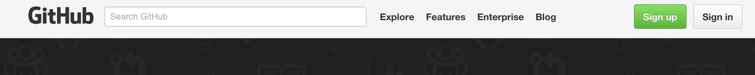
Creating a profile
Click on the signup button on the top-right
Choose a plan (one of them is free)
Remember your email and password!!!! You will need it again soon!!!!

Slide 13
III. Using Git with GitHub

Slide 14
Cloning a GitHub repo
Cloning == copying to your local computer
Like copying your Dropbox files to a new machine
First, change your working directory to where you want the repo you created to be stored: cd
Then, clone the repo: git clone <URL>
Get HTTPS or SSH URL from GitHub (ends in .git)
Clones to a subdirectory of the working directory
No visual feedback when you type your password
Navigate into the repo (cd) then list the files (ls)
Notes:
https://help.github.com/articles/set-up-git/

Slide 15
First Clone
First we will clone the main class repo!
You will need to do this to stay up to date with all of class info

Slide 16
Before Cloning
Move into a Directory that you want to store the info for the next 10 weeks
For my example, I will use my Desktop

Slide 17
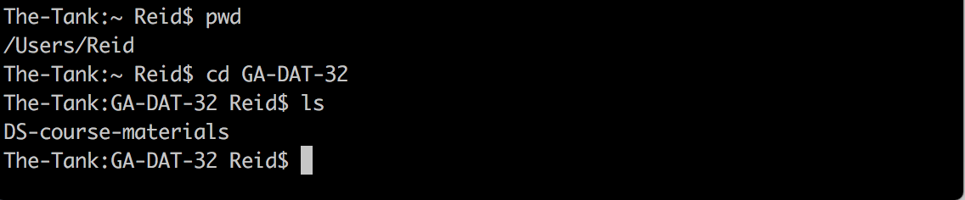
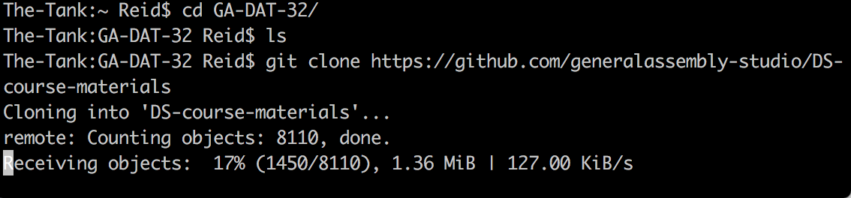
Before Cloning -- use pwd and ls
git clone https://github.com/reidoffringa/sfdat32.git
During Cloning

Slide 18
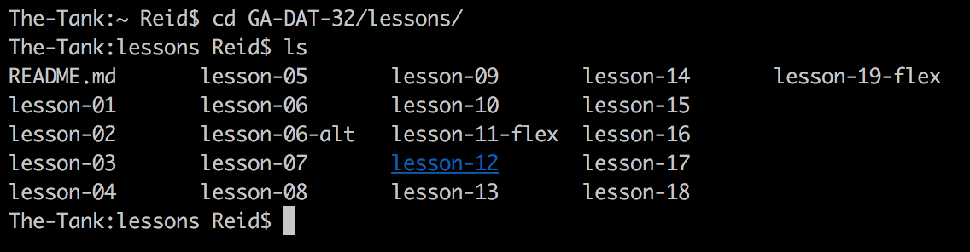
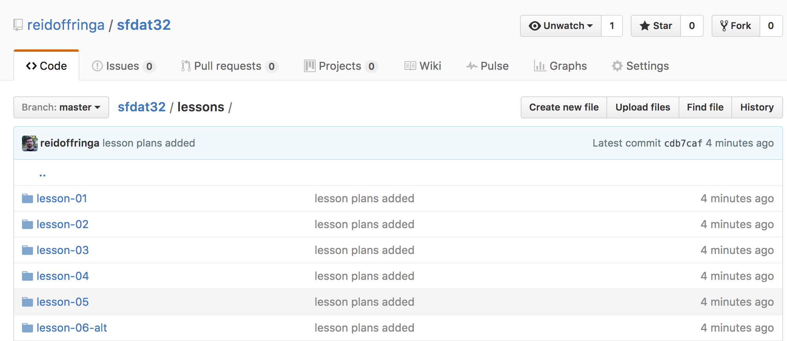
Same as on Github!
cd into it and ls
Try this now! (take 5 minutes)
note: a .gitignore file is “ignored” and is only there to prevent cross-platform failures

Slide 19
Second Clone
Now we will clone your new repo!
First we have to make one

Slide 20
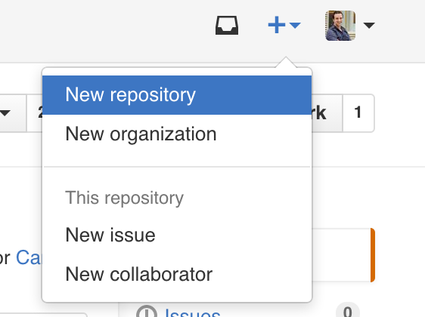
Creating a repo on GitHub
Click the plus sign and then “New respository” on your profile:
Define name, description, public or private
Initialize with README (if you’re going to clone)
Please call it sfdat32
Nothing has happened to your local computer
This was done on GitHub, the website

Slide 21
Preview of what you’re about to do
Initialize your repository
Make some file changes locally
Save those changes locally ( “add” and “commit” them)
Update your GitHub repo with those changes (“push”)

Slide 22
Preview of what you’re about to do
SUPER IMPORTANT:
Make sure that you LEAVE sfdat32 before cloning the new repo
cd ..
Never clone a git repo inside of another git repo!!!
You will regret this for the rest of your life

Slide 23
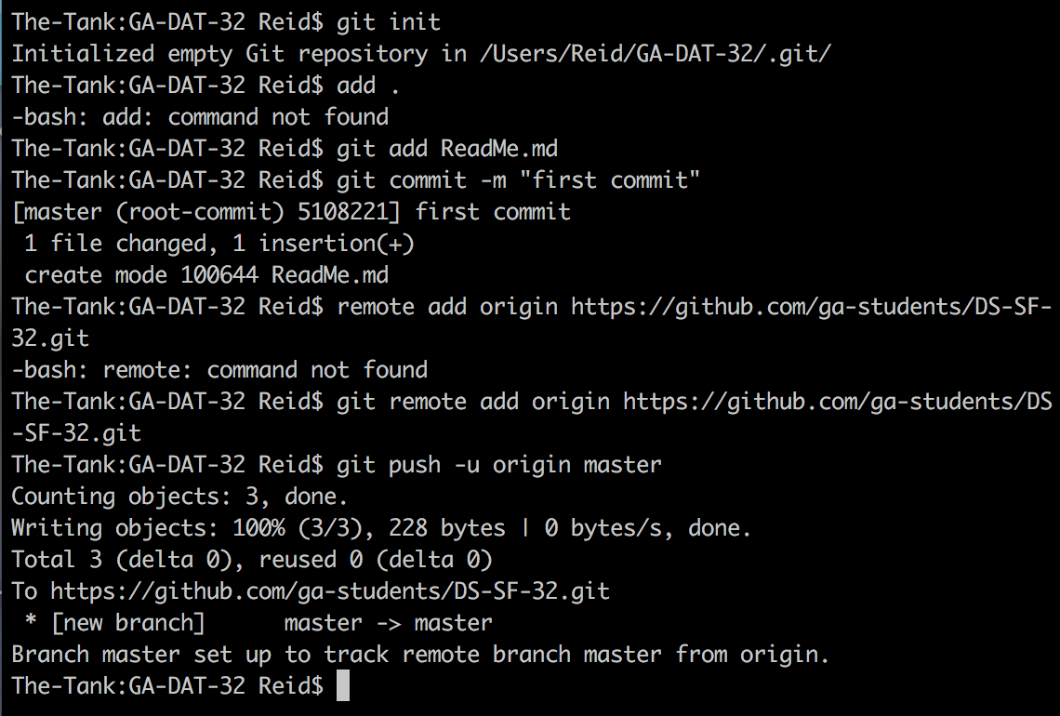
Preview of what you’re about to do

Slide 24
Making changes, checking your status
Making changes:
Create/Modify README.md in any text editor
Check your status:
git status
File statuses (possibly color-coded):
Untracked (red)
Tracked and modified (red)
Staged for committing (green)
Committed
Try this now! (take 1 minute)

Slide 25
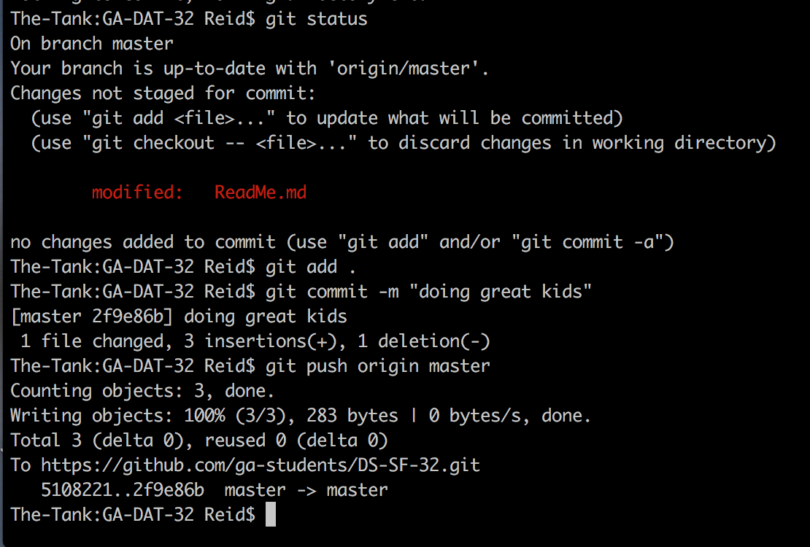
Making changes, checking your status

Slide 26
Committing changes
Stage changes for committing:
Add all “red” files: git add .
Commit changes:
git commit -m “message about commit”
Check your status again!
Try this now! (take 3 minutes)

Slide 27
Pushing to GitHub
Everything you’ve done to your cloned repo (so far) has been local
You’ve been working in the “master” branch
Push committed changes to GitHub:
Like syncing local file changes to Dropbox
git push <remote> <branch>
Often: git push origin master
Refresh your GitHub repo to check!

Slide 28
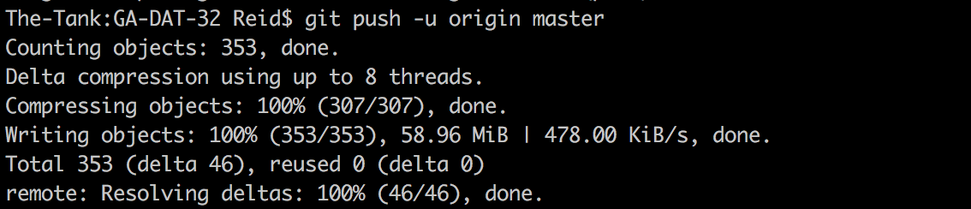

Slide 29
Quick recap of what you’ve done
Created a repo on GitHub
Cloned repo to your local computer (git clone)
Automatically sets up your “origin” remote
Made two file changes
Staged changes for committing (git add)
Committed changes (git commit)
Pushed changes to GitHub (git push)
Inspected along the way (git remote, git status, git log)

Slide 30
Before you leave today
Make a Github Profile on the web
Create your own repo, call it “sfdat32” and clone it to your machine
Clone the class repo

Slide 31
BREAK TIME
Grab some coffee, you’ve earned it because you’ve learned it.

Slide 32
IV. Bonus Content

Slide 33
Git installation and setup
Open Git Bash (Windows) or Terminal (Mac/Linux):
git config --global user.name “YOUR FULL NAME”
git config --global user.email “YOUR EMAIL”
Use the same email address you used with your GitHub account
Generate SSH keys (optional): tiny.cc/gitssh
More secure that HTTPS
Only necessary if HTTPS doesn’t work for you

Slide 34
Checking your remotes
A “remote alias” is a reference to a repo not on your local computer
Like a connection to your Dropbox account
View remotes: git remote -v
“origin” remote was set up by “git clone”
Note: Remotes are repo-specific

Slide 35
Two ways to initialize Git
Initialize on GitHub:
Create a repo on GitHub (with README)
Clone to your local machine
Initialize locally:
Initialize Git in existing local directory: git init
Create a repo on GitHub (without README)
Add remote: git remote add origin <URL>

Slide 36
Deleting or moving a repo
Deleting a GitHub repo:
Settings, then Delete
Deleting a local repo:
Just delete the folder!
Moving a local repo:
Just move the folder!

Slide 37
Excluding files from a repo
Create a “.gitignore” file in your repo: touch .gitignore
Specify exclusions, one per line:
Single files: pip-log.txt
All files with a matching extension: *.pyc
Directories: env/
Templates: github.com/github/gitignore

Slide 38
Gists: lightweight repos
You have access to Gist: gist.github.com
Add one or more files
Supports cloning, forking, commenting, committing
Can be public or secret (not private)
Useful for snippets, embedding, IPython nbviewer, etc.

Slide 39
Useful to learn next
Working with branches
Rolling back changes
Resolving merge conflicts
Fixing LF/CRLF issues

